Slide 1

Comparative Political Behavior
Timea Balogh
University of California, Davis

Slide 2

What IS comparative political behavior?
Political behavior focuses on the actions and attitudes of individuals, rather than the study of rules, institutions, or other aggregate factors
Generally studied empirically, often through opinion surveys or analyses of voting behavior
Comparative political behavior refers to the study of political behavior outside of the US context

Slide 3
What IS comparative political behavior?
Often looks at how behavioral outcomes vary by different institutional and contextual factors
E.g., How does voter turnout differ in proportional representation vs single member district electoral systems?
E.g., How does the presence of coalition governments influence voters’ perception of political parties’ ideological position?
E.g., Do legislative gender quotas increase voters’ feelings of representation and political involvement?

Slide 4
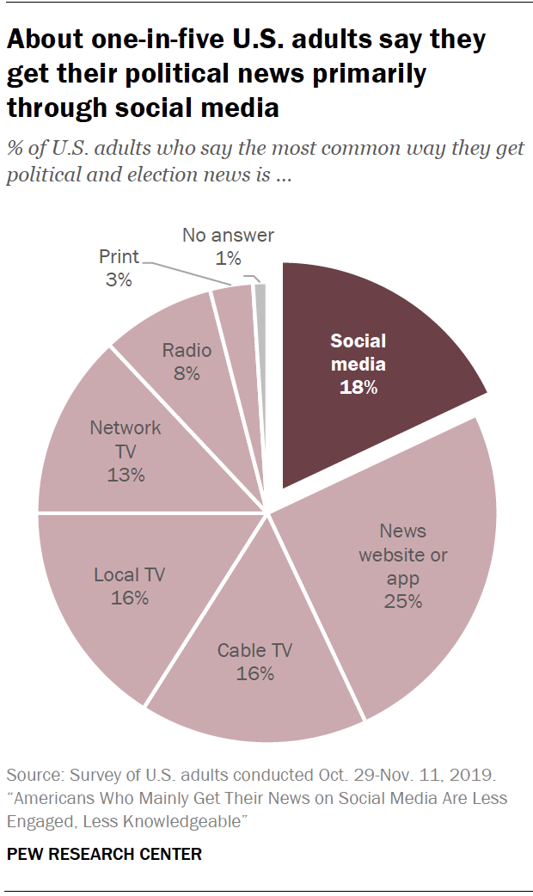
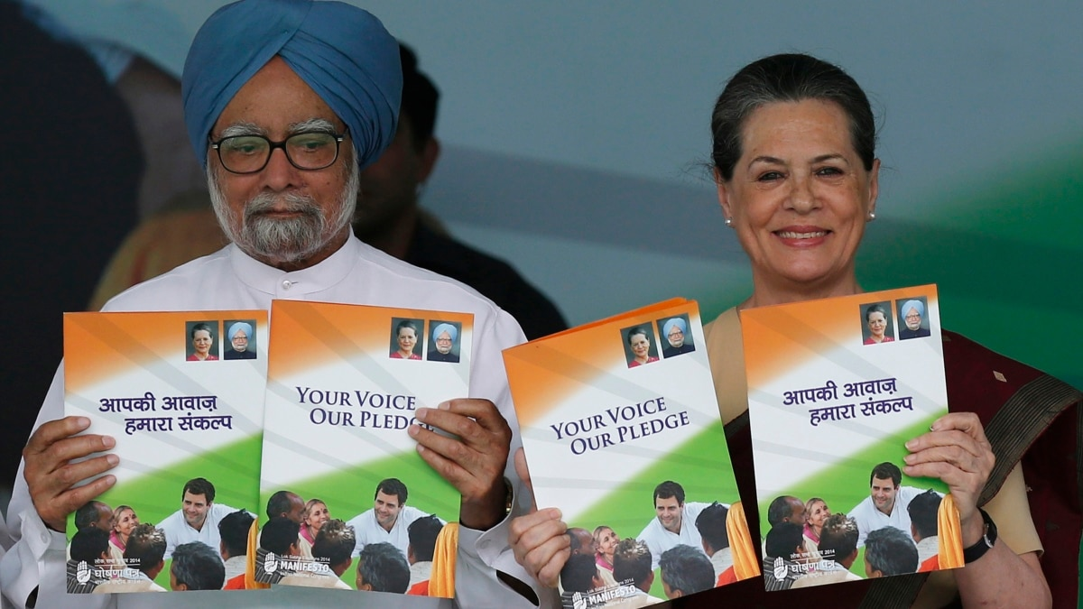
Step 1: Information Acquisition
Information Acquisition
Voters are exposed to political information through media, social interactions, campaigns, and personal experiences
Voters then perceive and interpret this information based on their existing psychological disposition, including beliefs, values, and cognitive biases
Exposure and perception/interpretation may be influenced by political interest and knowledge

Slide 5
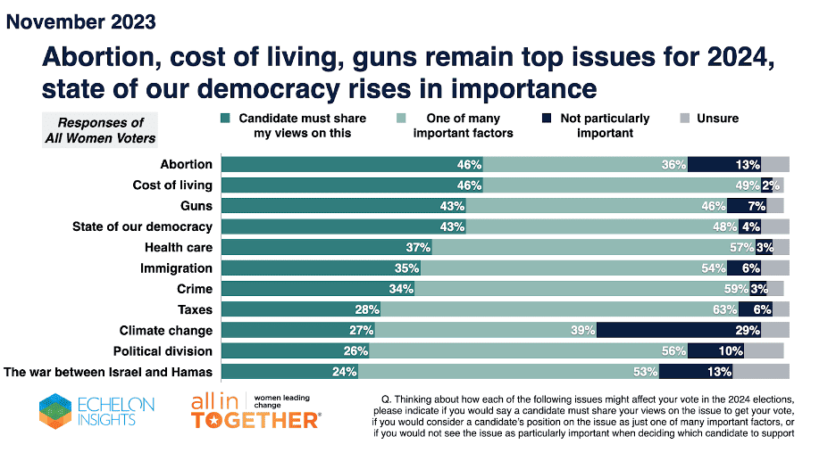
Step 2: Evaluation of Information
Evaluation of Information
Voters identify the most important issues to them (issue salience)
Not all issues matter equally to voters
You might have an opinion tax policy, but do you prioritize it compared to other issues?
Voters then assess candidates and parties based on their positions on these salient issues, as well as competence, integrity, past performance, and campaign promises
Includes Retrospective and Prospective considerations

Slide 6
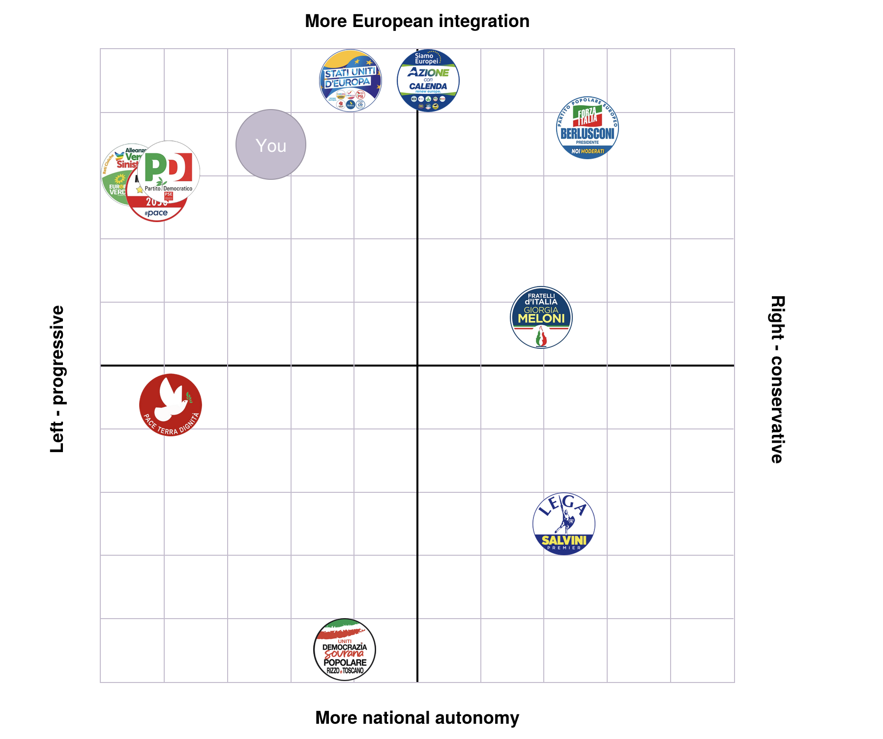
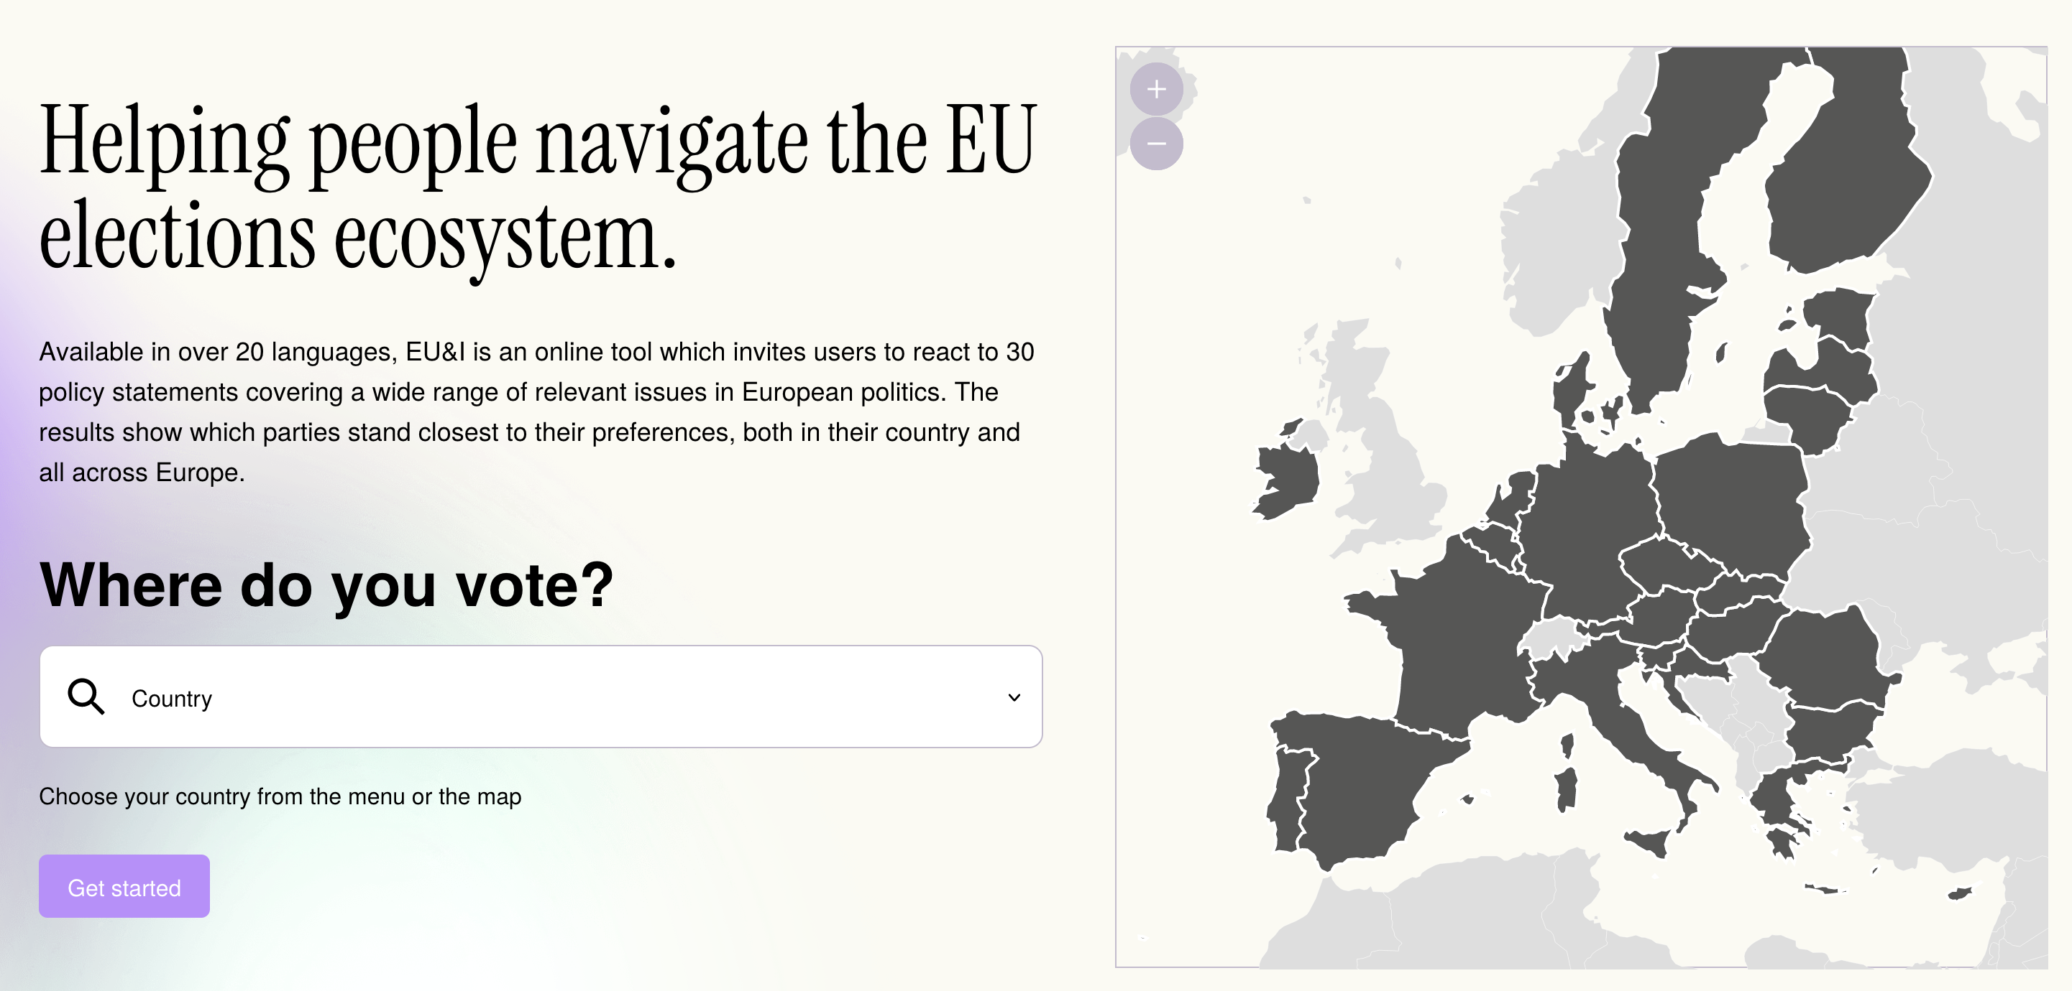
Step 3: Comparing Options
Comparing Options
How close is this party to me ideologically?
Proximity Voting, also known as Spatial Voting
How competent and likely to succeed is this candidate?
Valence Voting
Does this party’s proposed policy changes move in my desired direction?
Directional Voting
Click here to see which party is closest to you!

Slide 7
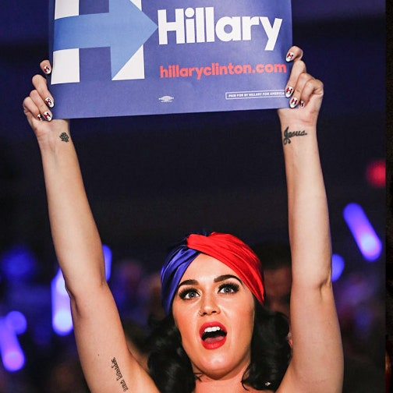
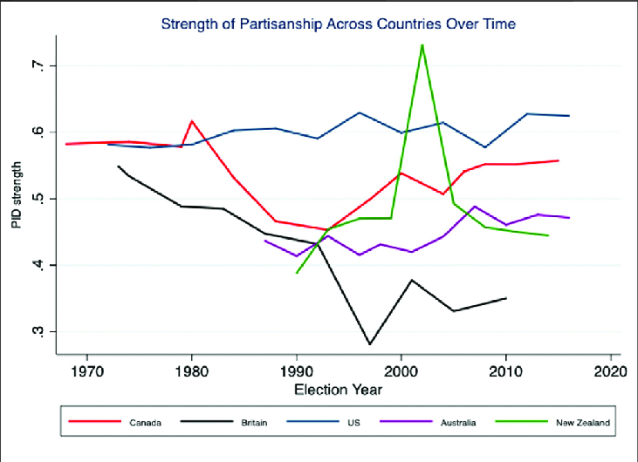
Step 4: Heuristics and Other Influences
Heuristics and Other Information Shortcuts
Heuristics are cognitive or information shortcuts that simplify complex decision making processes
Party identification and Partisanship: Strongly identifying with a political party can significantly influence voting decisions
Graph: Bittner (2021)
Social factors: Voters are influenced by their social environments, including friends, family, community, and other social networks
Endorsements by interest groups or other political/non-political actors
Candidate characteristics
Why heuristics?
Political information is complex and most voters have limited knowledge and time!

Slide 8
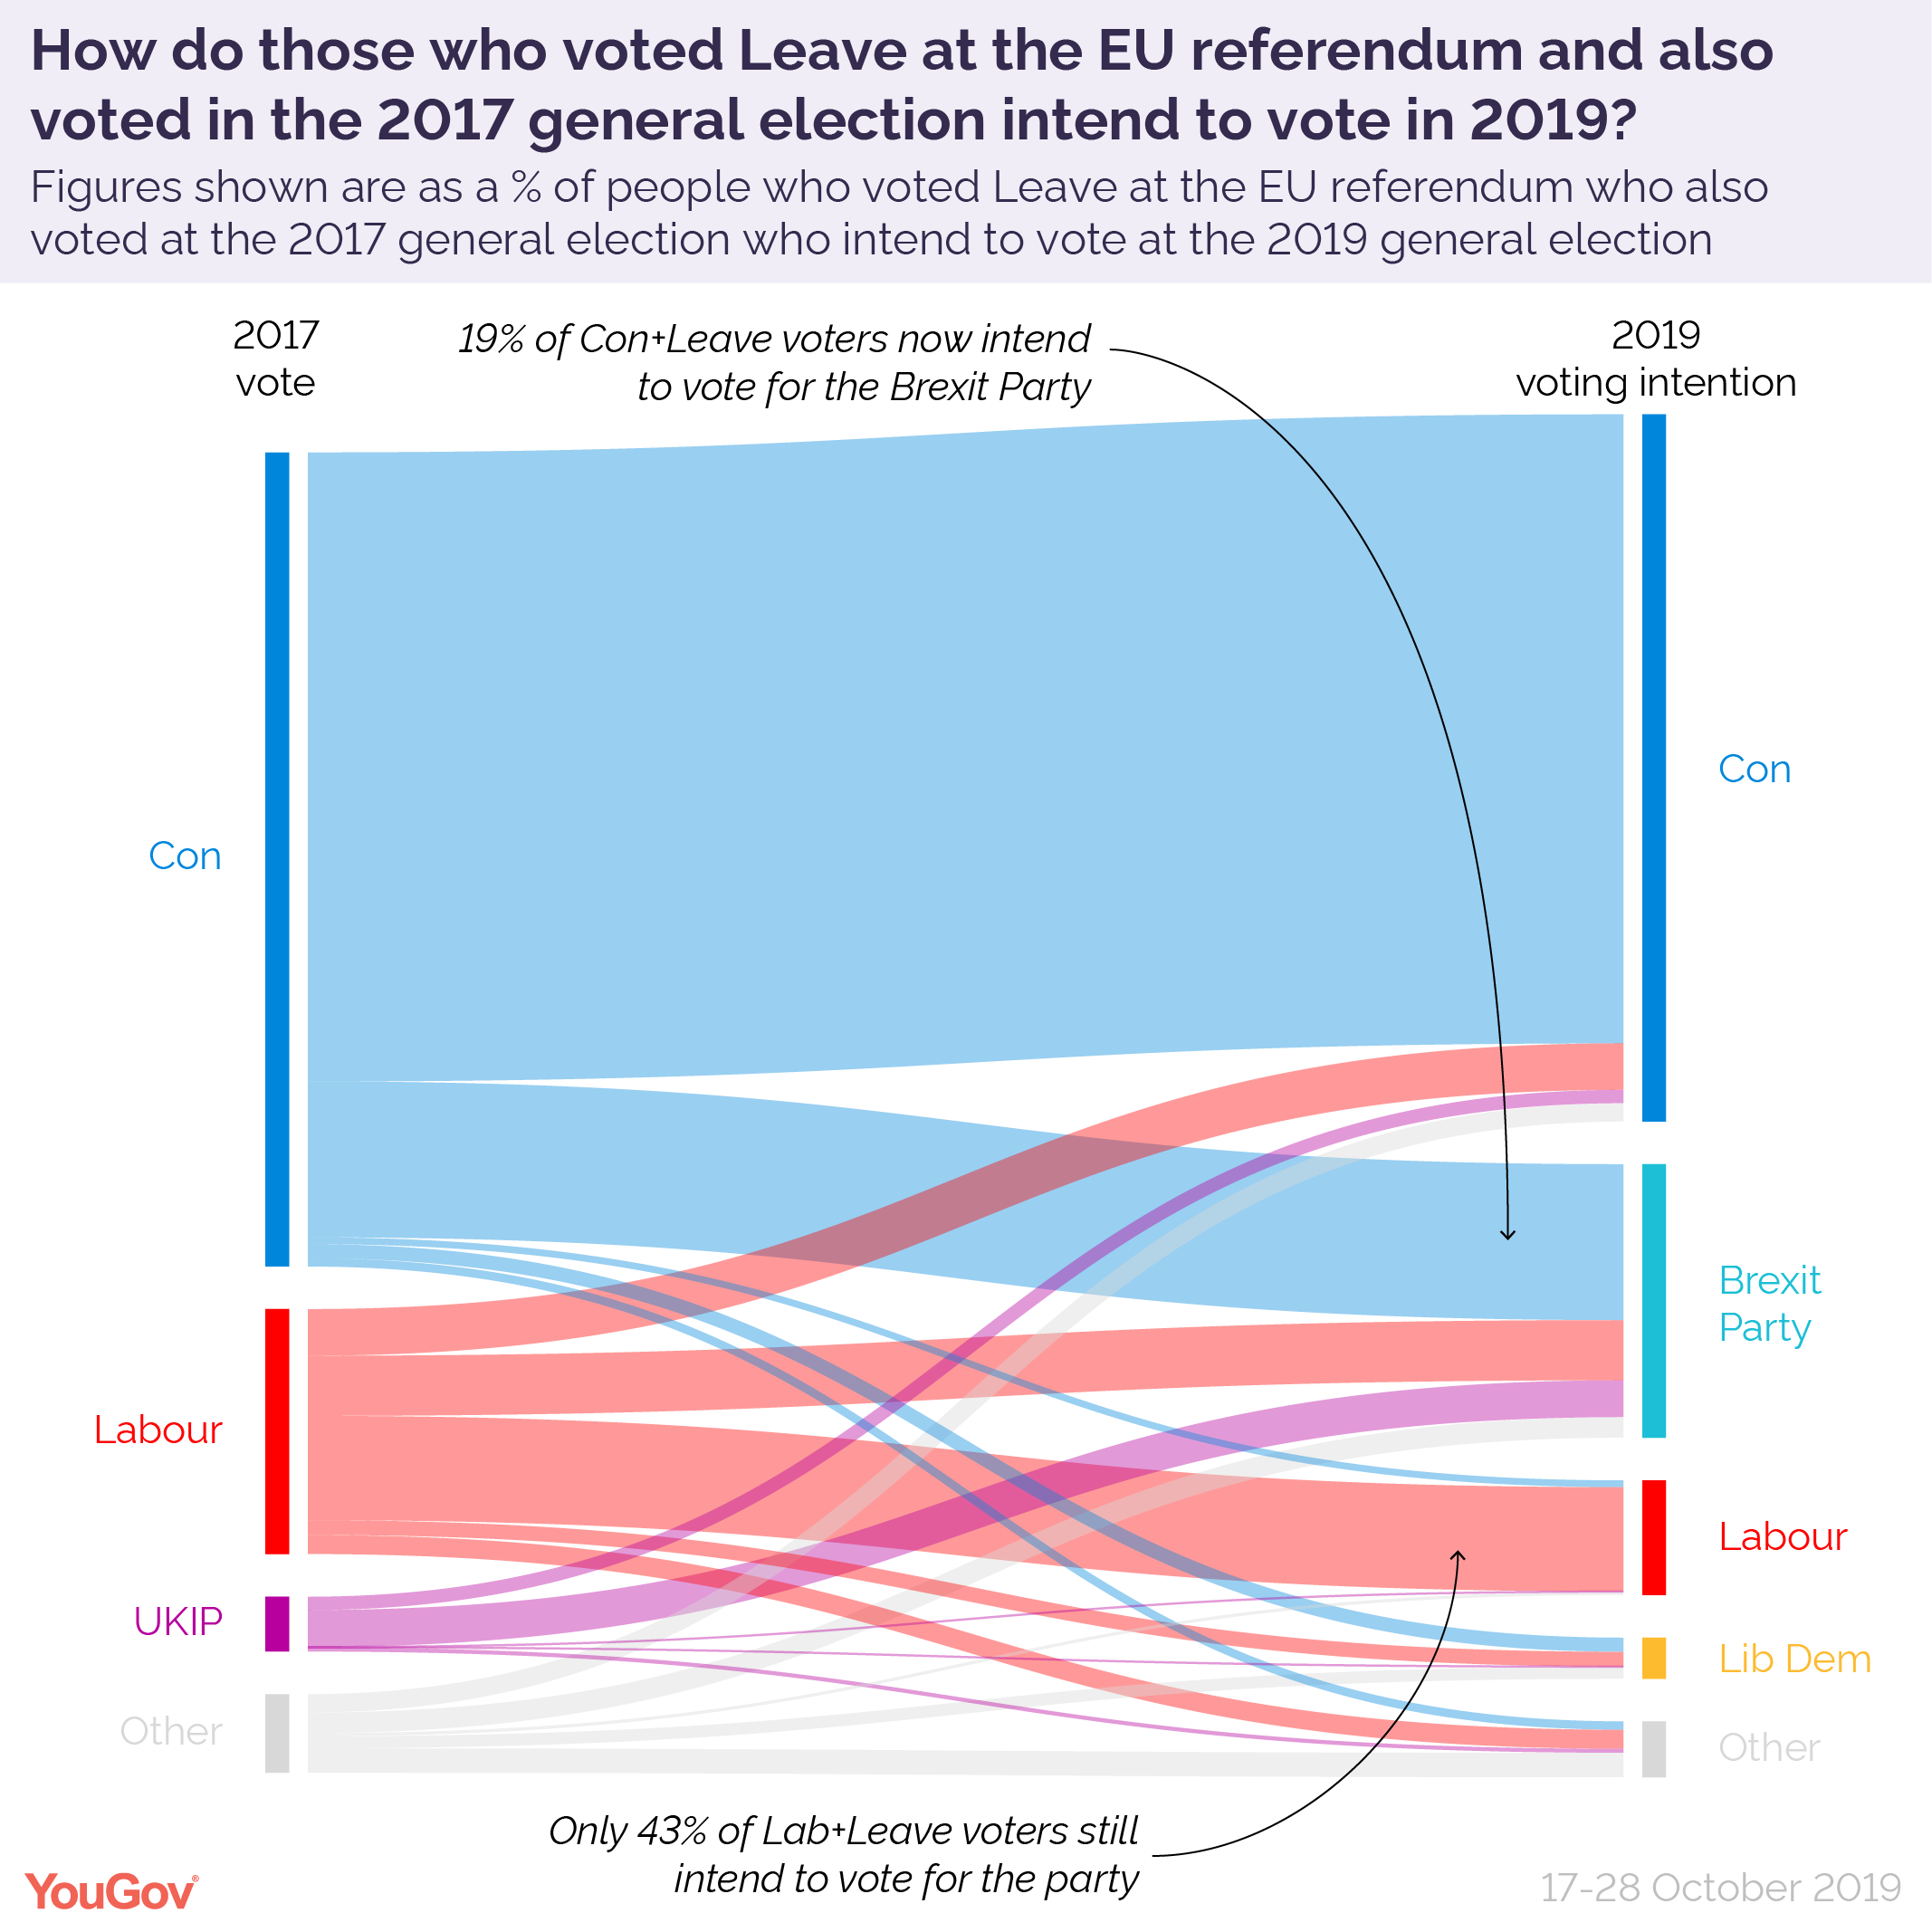
Vote switching (voting for one party in one election and another party in another) is more common in UK than US! Reflects weaker party attachments

Slide 9
Step 5: Decision, Monitoring, and Adjustment
Decision, Monitoring, and Adjustment
After considering the options, voters come to a final decision on which candidate or party to support
After the election they may monitor the performance of the elected candidates and adjust their future voting accordingly
Retrospective Voting

Slide 10
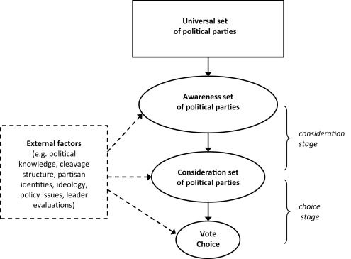

Slide 11
Some Theories of Voting Behavior
Retrospective Voting: Voting is based on the performance of the incumbent politicians or parties
Perceived as having done well? Rewarded by voting for incumbent
Perceived as having done poorly? Punished by voting for opposition
Prospective Voting: Voting is based on anticipated future performance of candidates or parties
Consider the policy promises made and choose the one they align with most
Issue Voting: Voting is based on specific political issues (policies) that the individual prioritizes
If you prioritize environmental policy, you will choose the candidate with the strongest environmental platform

Slide 12
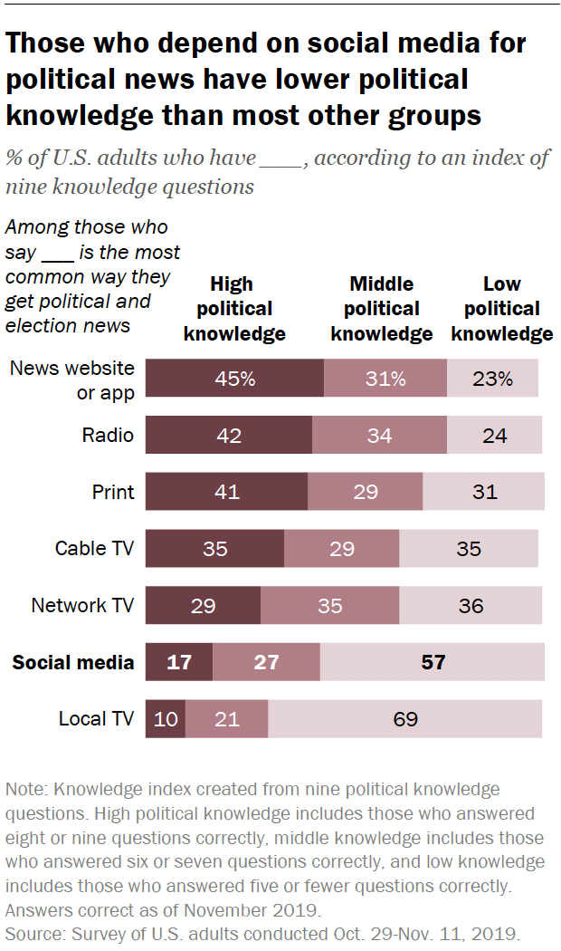
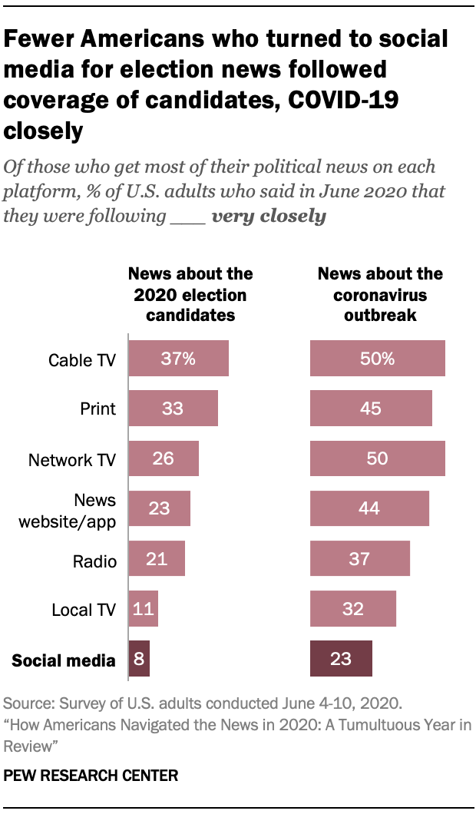
Some complications: News Sources
Where people get their political news from matters!
Those who rely on social media for political news followed the 2020 presidential candidates less closely, less aware of political storylines
Also less likely to very closely follow news about the COVID-19 outbreak
Notes:
Political knowledge is measured here using a variety of political questions that have objective correct answers
High political knowledge is those respondents that got most of these questions correct (8 or 9 right out of 10), low political knowledge is those respondents that got many of them wrong (5 or fewer right out of 10)

Slide 13
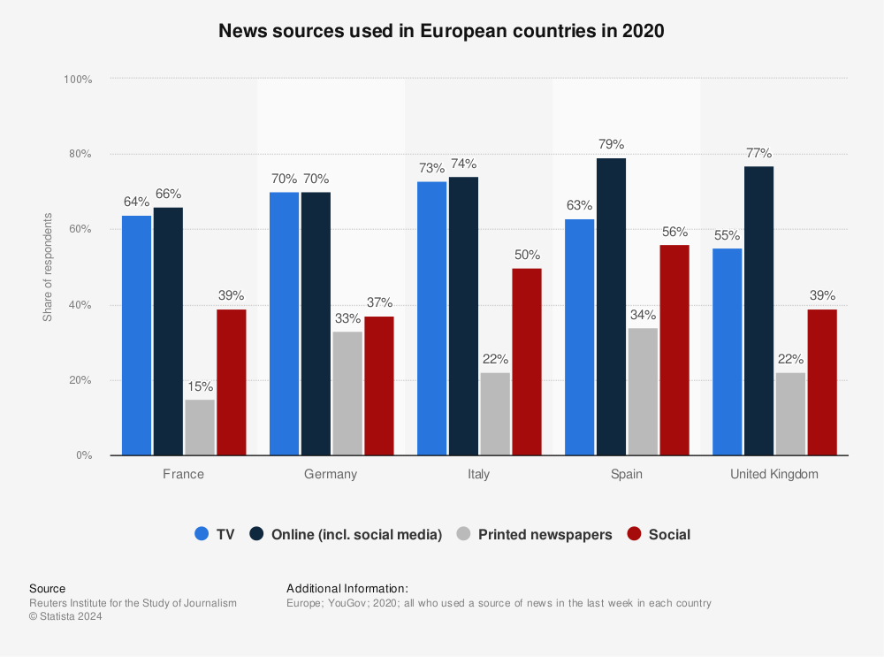
Some complications: News Sources
Where people get their political news from matters!
Those who rely on social media for political news followed the 2020 presidential candidates less closely, less aware of political storylines
Notes:
f

Slide 14
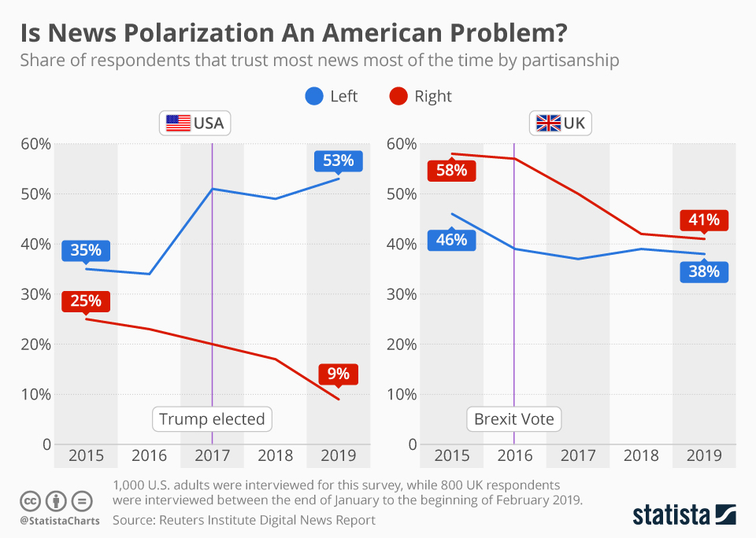
Some complications: News Sources
Trust in news also matters and varies considerably across contexts!
US is deeply polarized on trust in news, with only 9% of right-leaning respondents saying they trust most news most of the time
Compared to UK, where 41% of right-leaning respondents trust most news most of the time
Self perpetuating cycle, exacerbates polarization
Notes:
f

Slide 15
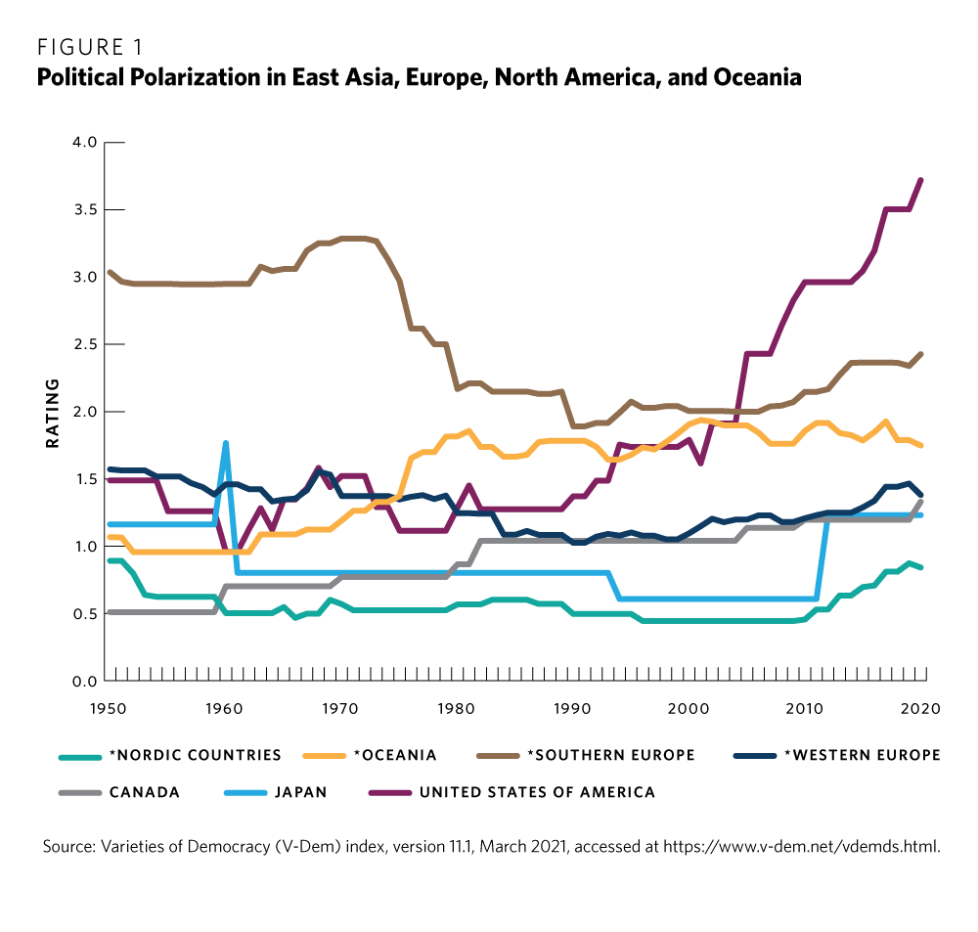
Some complications: Polarization
Political polarization can affect the voting calculus, especially by strengthening partisan divides
Political polarization in the United States reflects a three-decade-old trend of partisan sorting
The two parties reinforce urban-rural, religious-secular, and racial-ethnic cleavages rather than promote cross-cutting cleavages
Regardless of ideological similarity, ”us vs them” makes it consider other options
Especially when only a binary choice

Slide 16

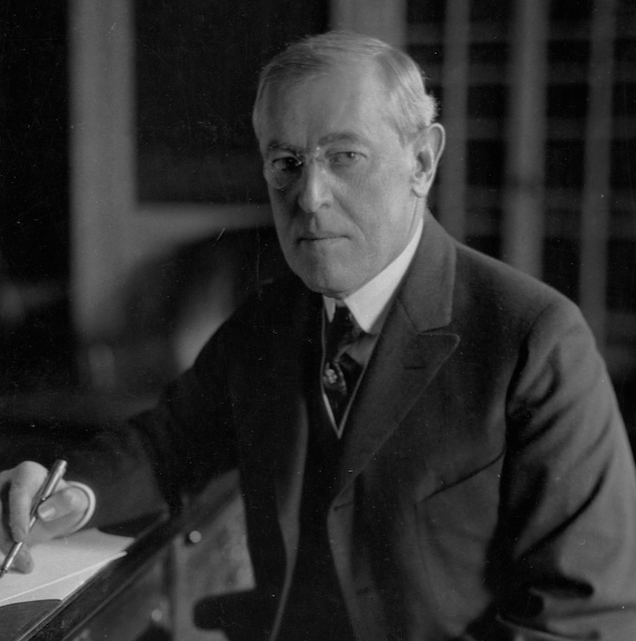

Some complications: Shark Attacks & Voting?
I demand the shark community increase their attacks immediately!
Achen and Bartels (2002)
New Jersey beach communities affected by shark attacks during the summer of 1916 had 10 percentage points fewer votes for Woodrow Wilson compared to communities without shark attacks
Challenges retrospective voting: only works if voters can distinguish between changes in life circumstances that are caused by politicians
But can they?
Wilson did not order sharks to attack people…

Slide 17
Let’s talk about measurement!

Slide 18
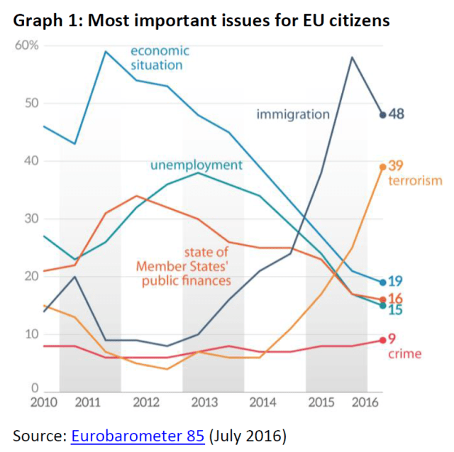
Measuring issue salience
Let’s say a researcher is interested in how the prioritization of certain issues over others affects voting behavior? Where do they get data on issue priorities?
E.g., Comparative Study of Electoral Systems (CSES)
What has been the most important issue to you personally in this election?
What do you think is the most important political problem facing [your country] today?
E.g., Eurobarometer
What do you think are the two most important issues facing [your country/EU] at the moment?

Slide 19
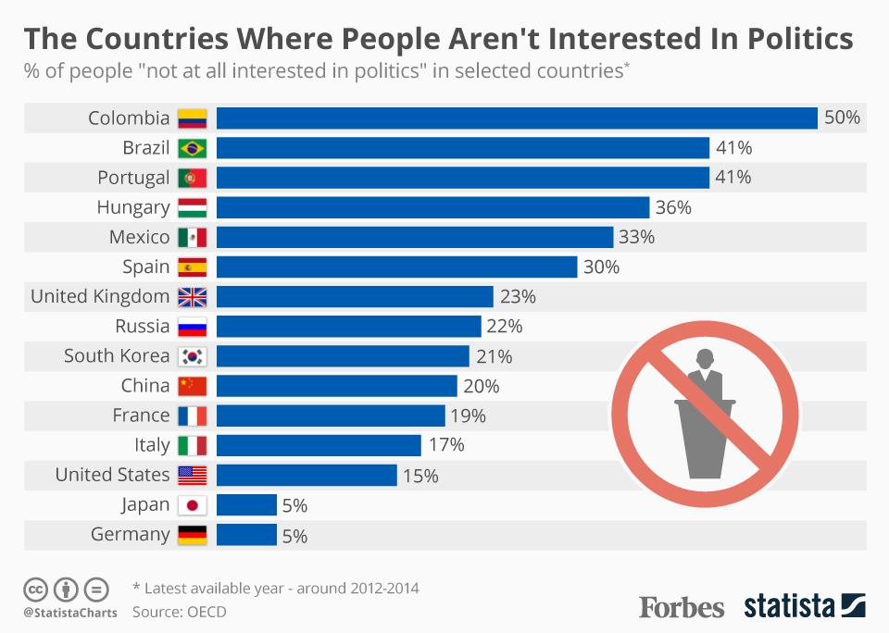
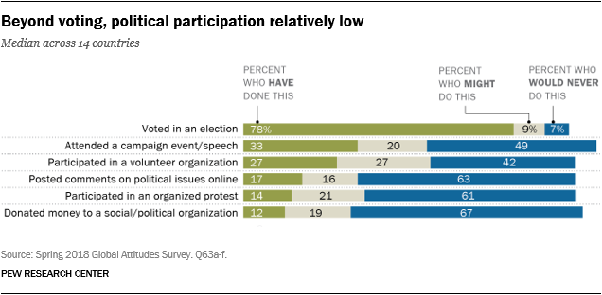
Measuring political interest
Let’s say a researcher is interested in how an individual’s political interest affects how they vote and engage with politics. Where do we get data on this?
E.g., Eurobarometer
To what extent would you say you are interested in politics?
A great deal, to some extent, not much, not at all
In general, do you pay attention to news about each of the following?
Politics, Foreign policy/international affairs, Education, Health care, Poverty, The European Union, The Economy, Sport, The Environment, Culture

Slide 20
Measuring parties’ policy positions
Many of us in comparative political behavior need data on parties, their platforms, and promises across elections and countries. Where can we get this data?
Comparative Manifesto Project (CMP)/MARPOR
Goal is to measure policy positions of all relevant parties competing in any democratic election in post WWII period
Data for OECD, EU members, Central and Eastern Europe, Latin America, and South East Asia
What is a manifesto?
It is the election program by the party.
The text published by a political parties in order to compete for votes in an election
Why use manifestos?
They contain a party’s only authoritative policy statements
Are indicators of parties’ policy preferences at a given point in time
Allow us to compute valid and reliable measurements of party policy position
Party’s position is measured as the difference in the % of right-wing associated text mentions and left-associated text mentions

Slide 21
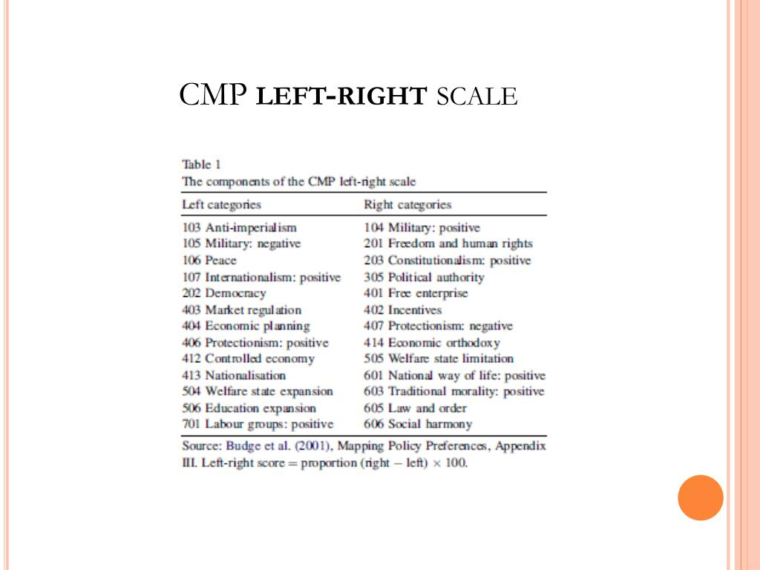

Slide 22
Measuring parties’ policy positions
Many of us in comparative political behavior need data on parties, their platforms, and promises across elections and countries. Where can we get this data?
Chapel Hill Expert Survey
Estimates party positioning on ideology and policy issues, and international relations for national parties in countries across the world
CHES-Europe, 6 waves, 1999-2019, 32 countries, including all EU member states
CHES-Latin America, new in 2020, 112 national parties in twelve Latin American countries

Slide 23
Class Activity
For participation, I would like you to answer the following discussion question in groups of up to 4 people. Upload your answer to Canvas with all group members’ names at the top
How can theories of political behavior help us understand the rise of populist parties in response to the European refugee crisis of 2015 in countries like Germany and Sweden?
Consider factors such as: the perception of certain groups by voters, what policies parties offer voters, media framing and coverage, social identity, and salience (importance) of the certain events.

